Slide 1
GUN TYPE SPOT WELDING MACHINE

Slide 2
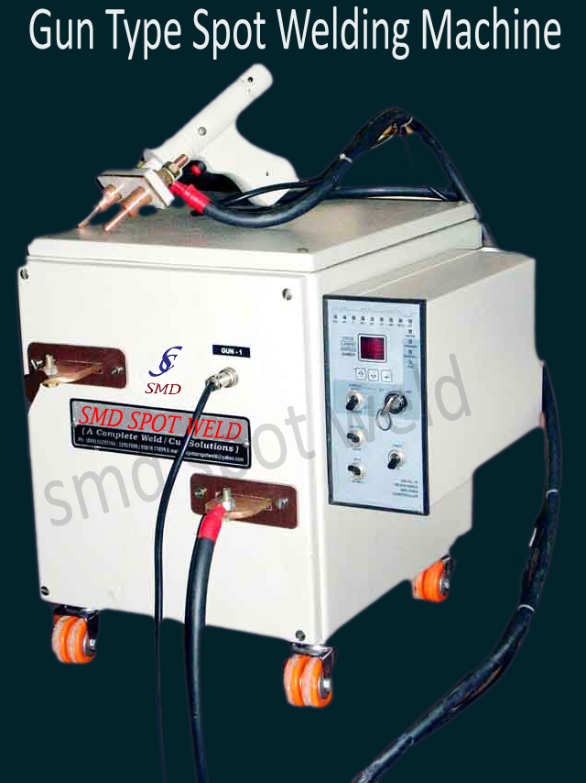

Slide 3
GUN TYPE SPOT WELDING MACHINE
KVA | 15to25 kva
Type | Gun type flexible arm spot weld
Gun operation | manual hand operated
Gun cable length | 300-600mm
Input volt | 415 volt (2 phase)
Throat depth | 100 mm (detachable gun)
Welding thickness | 0.5 to 1mm x2[SS material]
Tip size | 12mm Dia CR-CU
Control | SCR control/weld timer(or) microprocessor control

